Slide 1
INFO 6150 : Web Design and User Experience Engineering
Title: Tails Up
Team: Outliers
Team Members:
Anutej Poddaturi [002922161] | Priyanka Prakash Khimyani [002770021] | Suraj Balaso Desai [002778614] | Lissa Rodrigues [002769776]

Slide 2
Agenda
Project Description
Features
Tech Stack
Contributions
ScreenShots

Slide 3
Project Description
Tails Up is a one-stop shop for people who require temporary dog care for their canine companions. The user would be able to publish requests for someone to look after the dog while they were away. The pet parent may also look for other pet parents to mate their canines with by clicking on a certain user and finding out more about them. They would also be able to arrange activities for their pets to attend or find them to join.

Slide 4
Features
- As a user one should be able to login / Signup.
- Pet parents can access all tabs (pet parents, volunteers, events, posts).
- Volunteers have specific tabs access.
- Only a pet parent can create Posts for service request.
- User can host events and they can search for a specific event. They can edit or update their events.
- Pet parent can delete only his own post
- Users can update their details

Slide 5











Tech Stack
BACKEND | MIDDLEWARE | FRONTEND
Axios, React-Notifications
REST API

Slide 6
Contributions
Priyanka
Suraj
Anutej
Lissa
User Login and Signup
Navbar
Pet Parents Page
Volunteers Page
Posts Tab
Create and delete posts
Service Request Emails
Loader Component
Events Tab
Create Delete and Register for events
Events Search Functionality
Dog API to fetch dog breeds during registration
Volunteer Rating

Slide 7
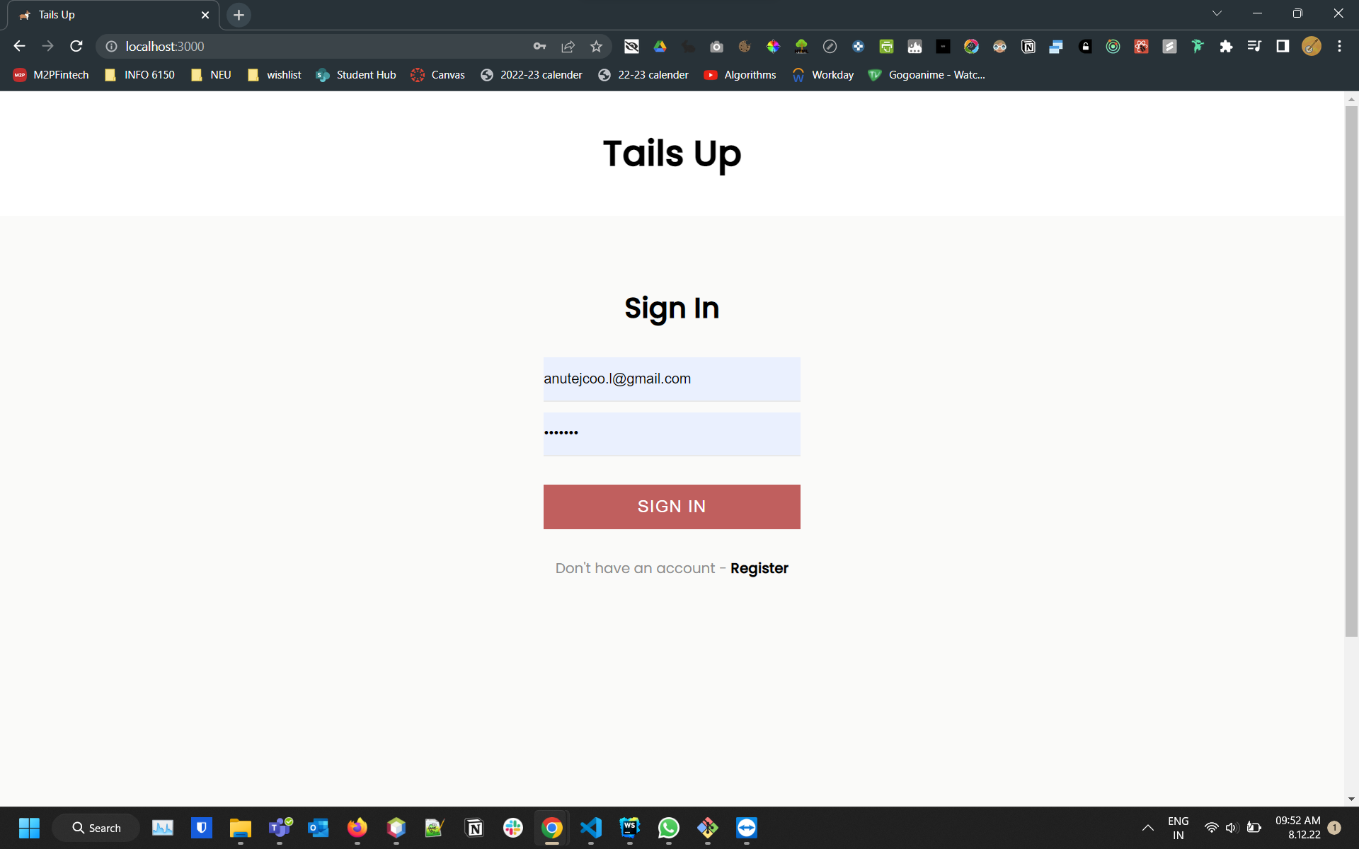
ScreenShots
Sign In Page

Slide 8
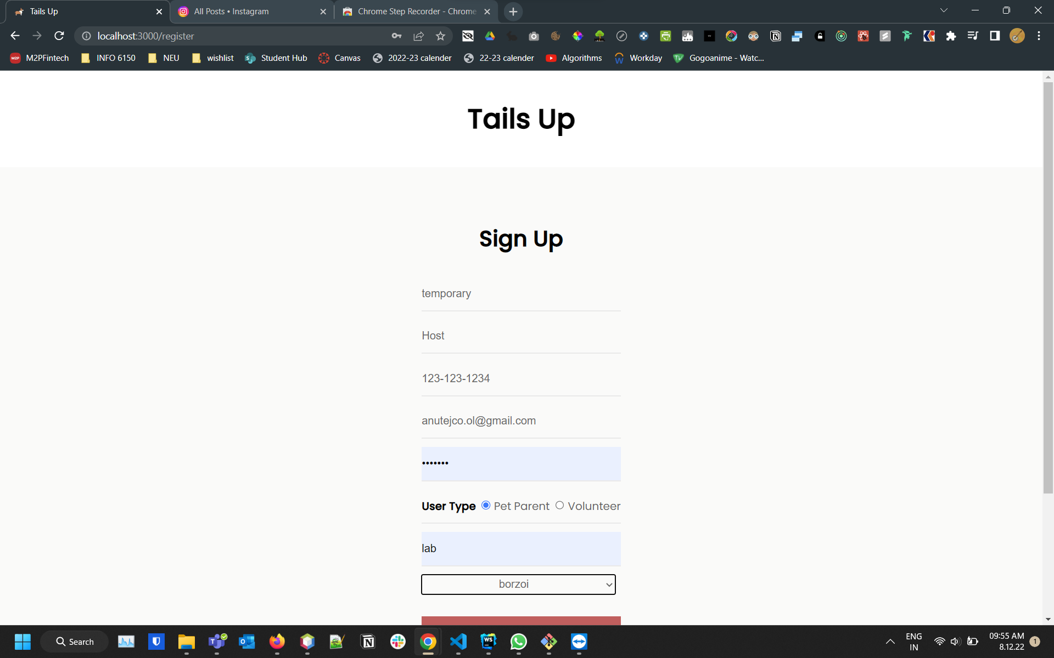
Registration Page

Slide 9
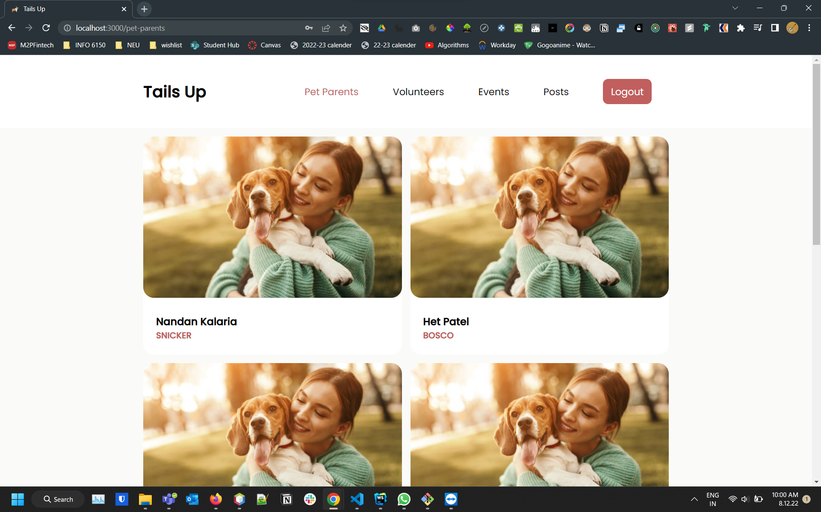
Pet Parents Landing Page

Slide 10
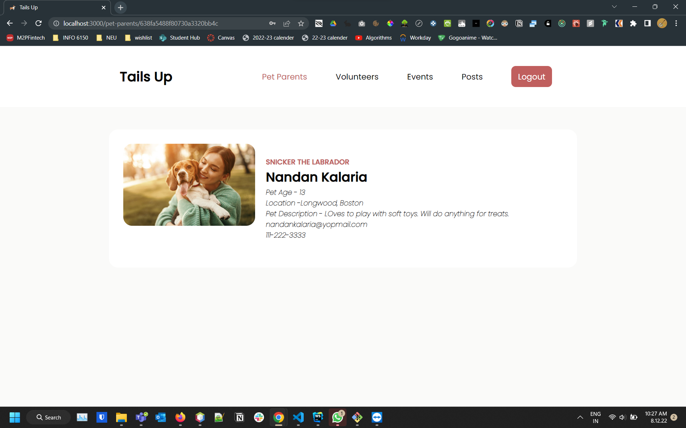
Pet Parent Detail Page

Slide 11
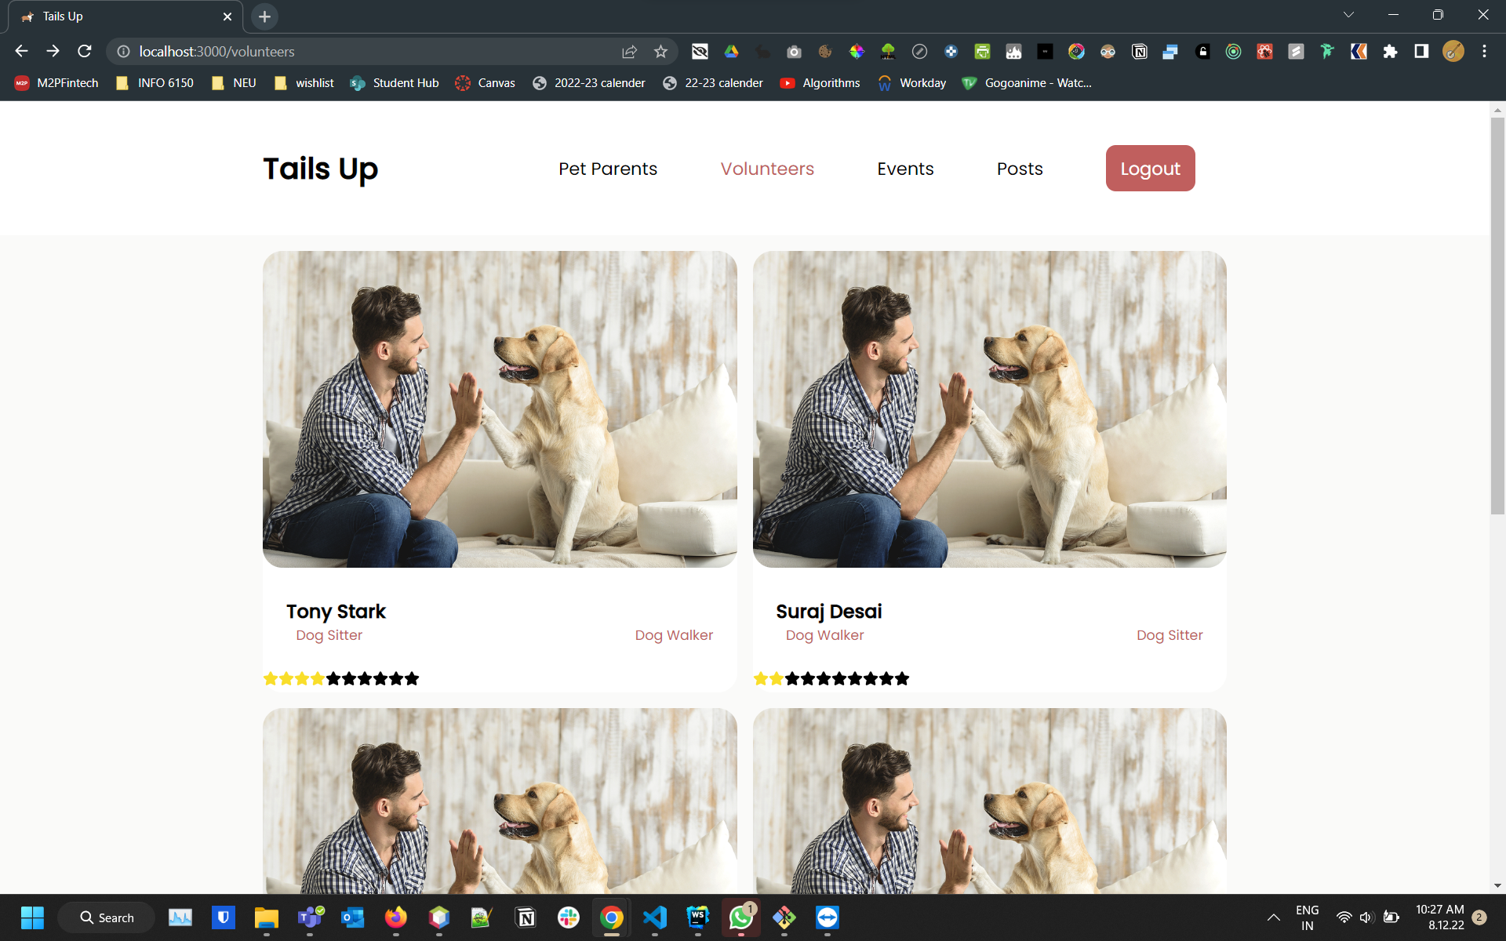
Volunteers Tab

Slide 12
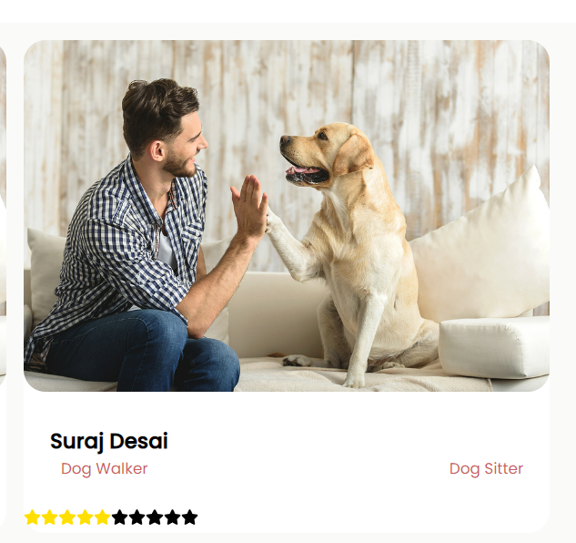
Volunteers Rating

Slide 13
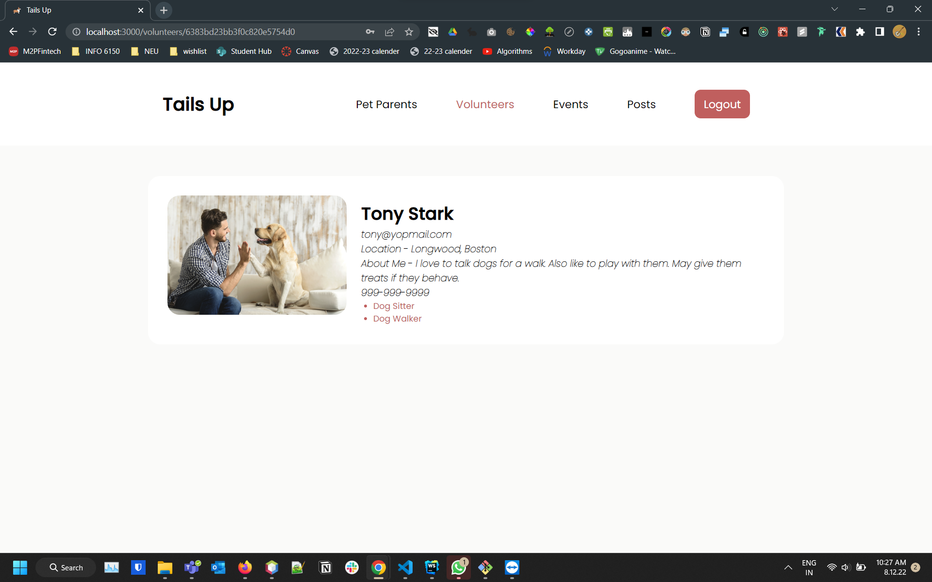
Volunteer Detail Page

Slide 14
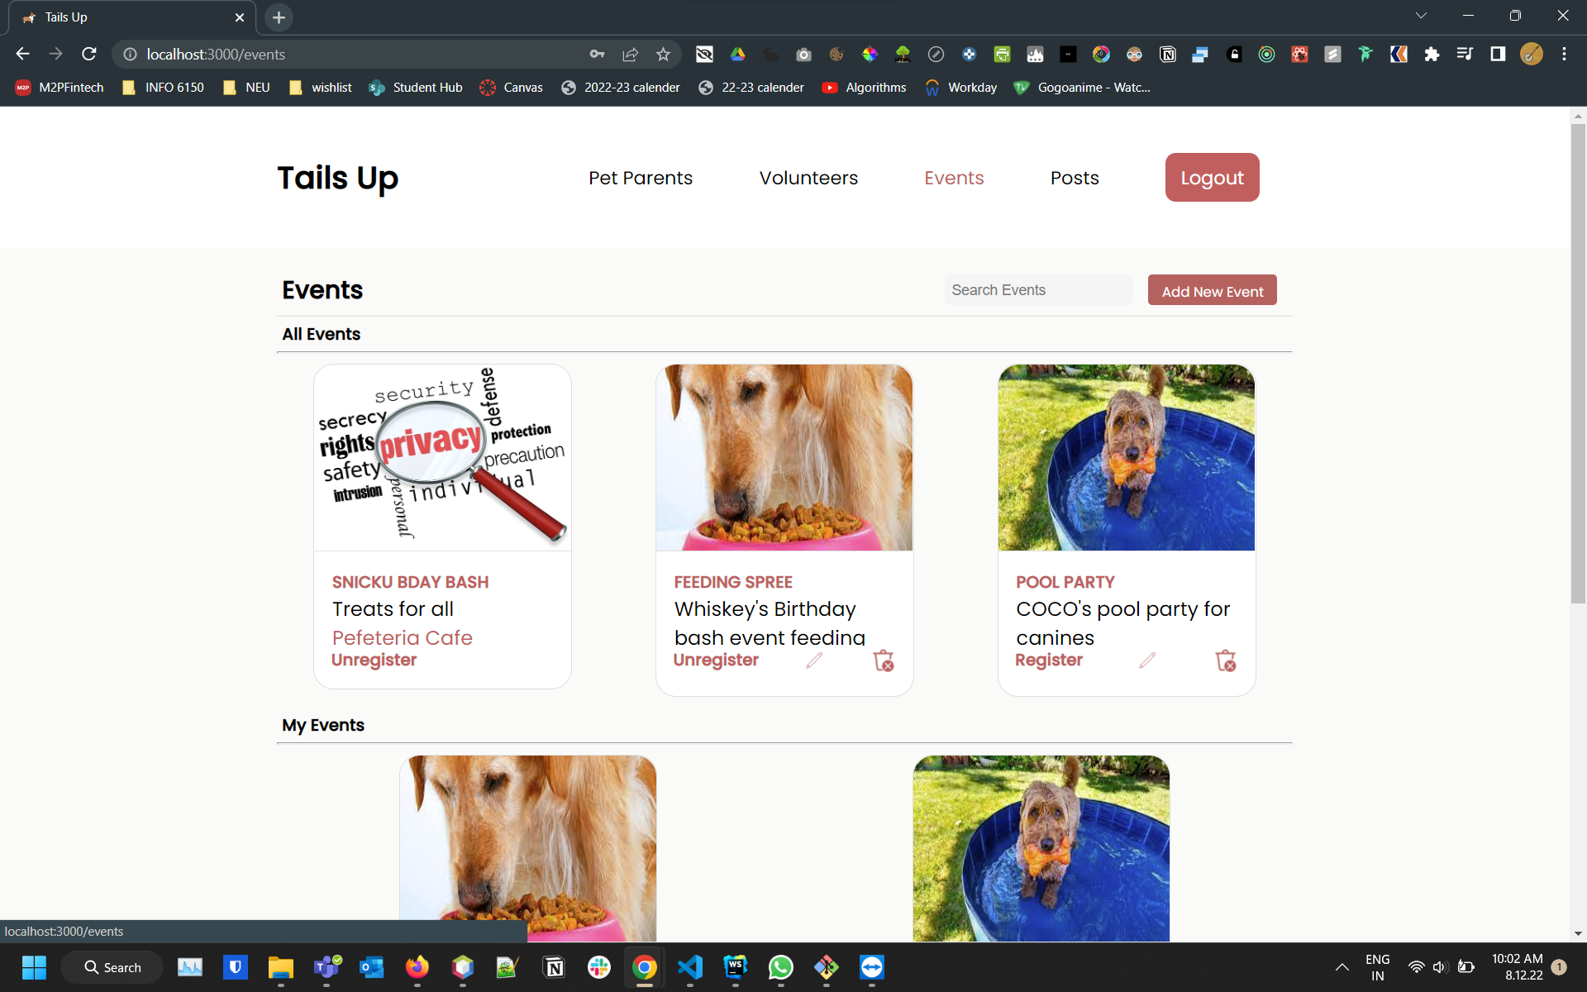
Events Tab

Slide 15
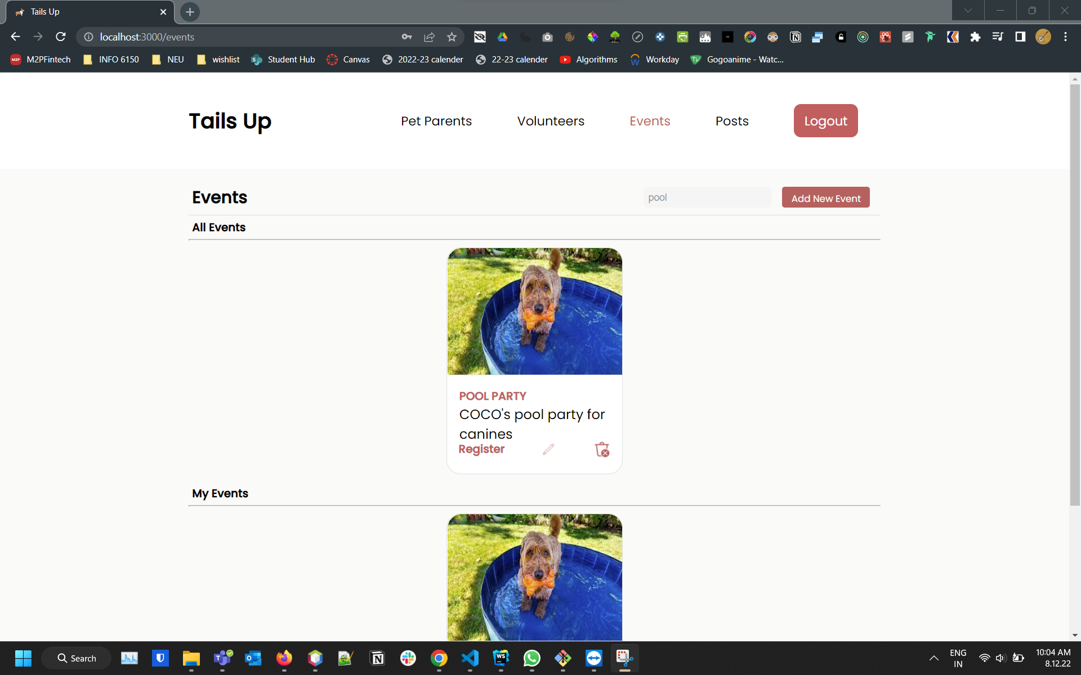
Events Search Functionality

Slide 16
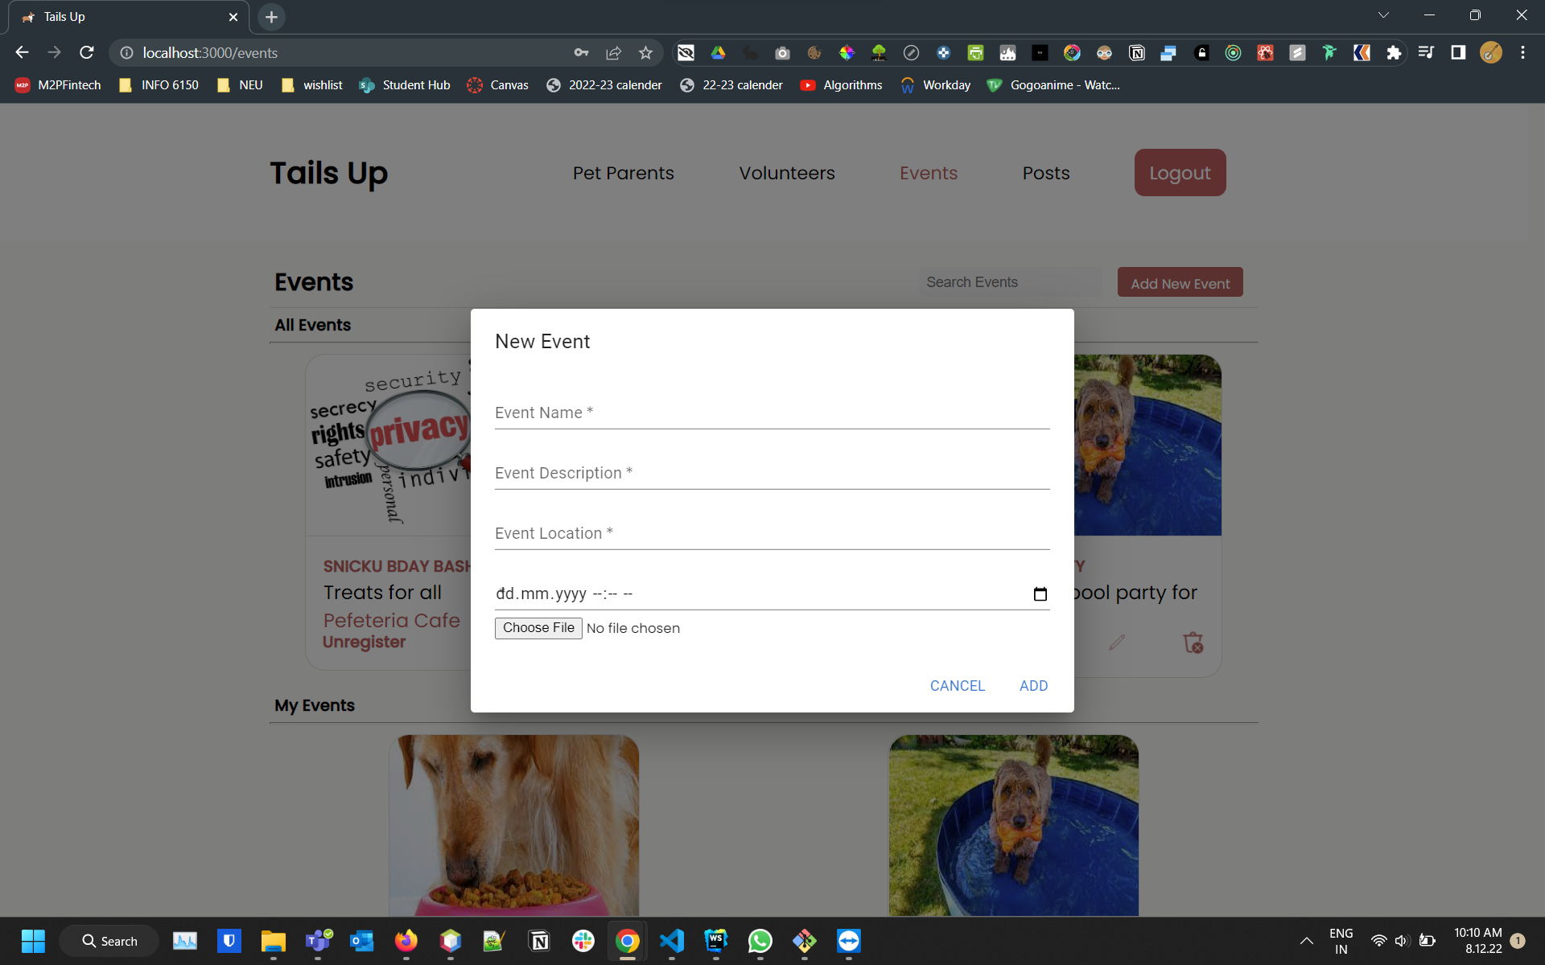
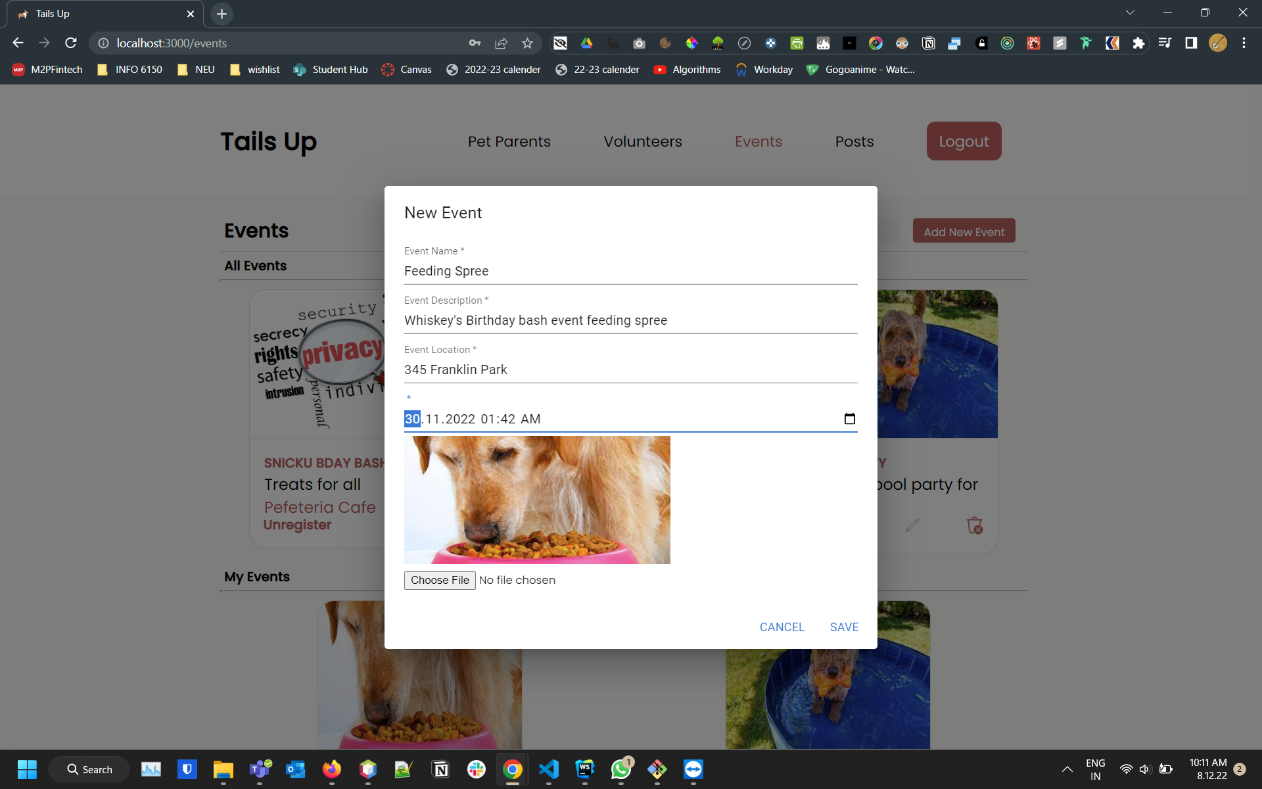
Event creation and updation models

Slide 17
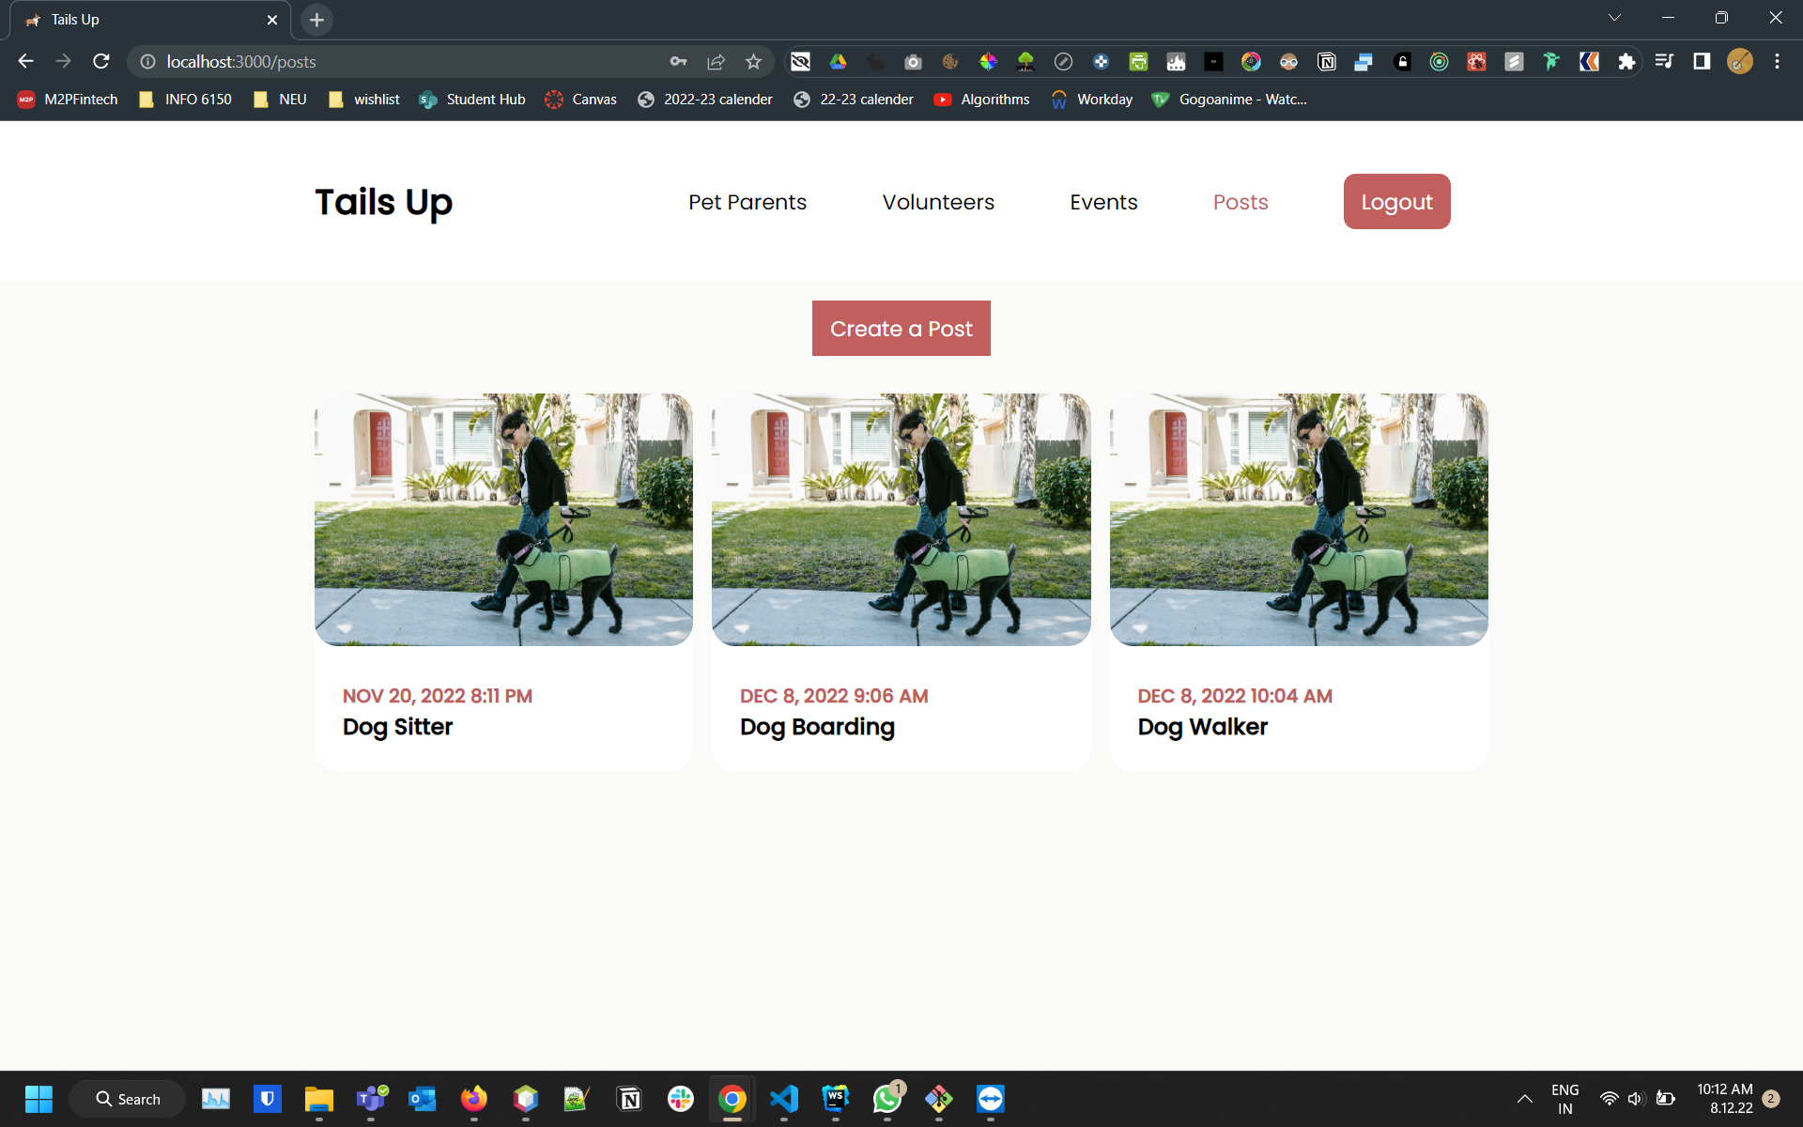
Posts Tab

Slide 18
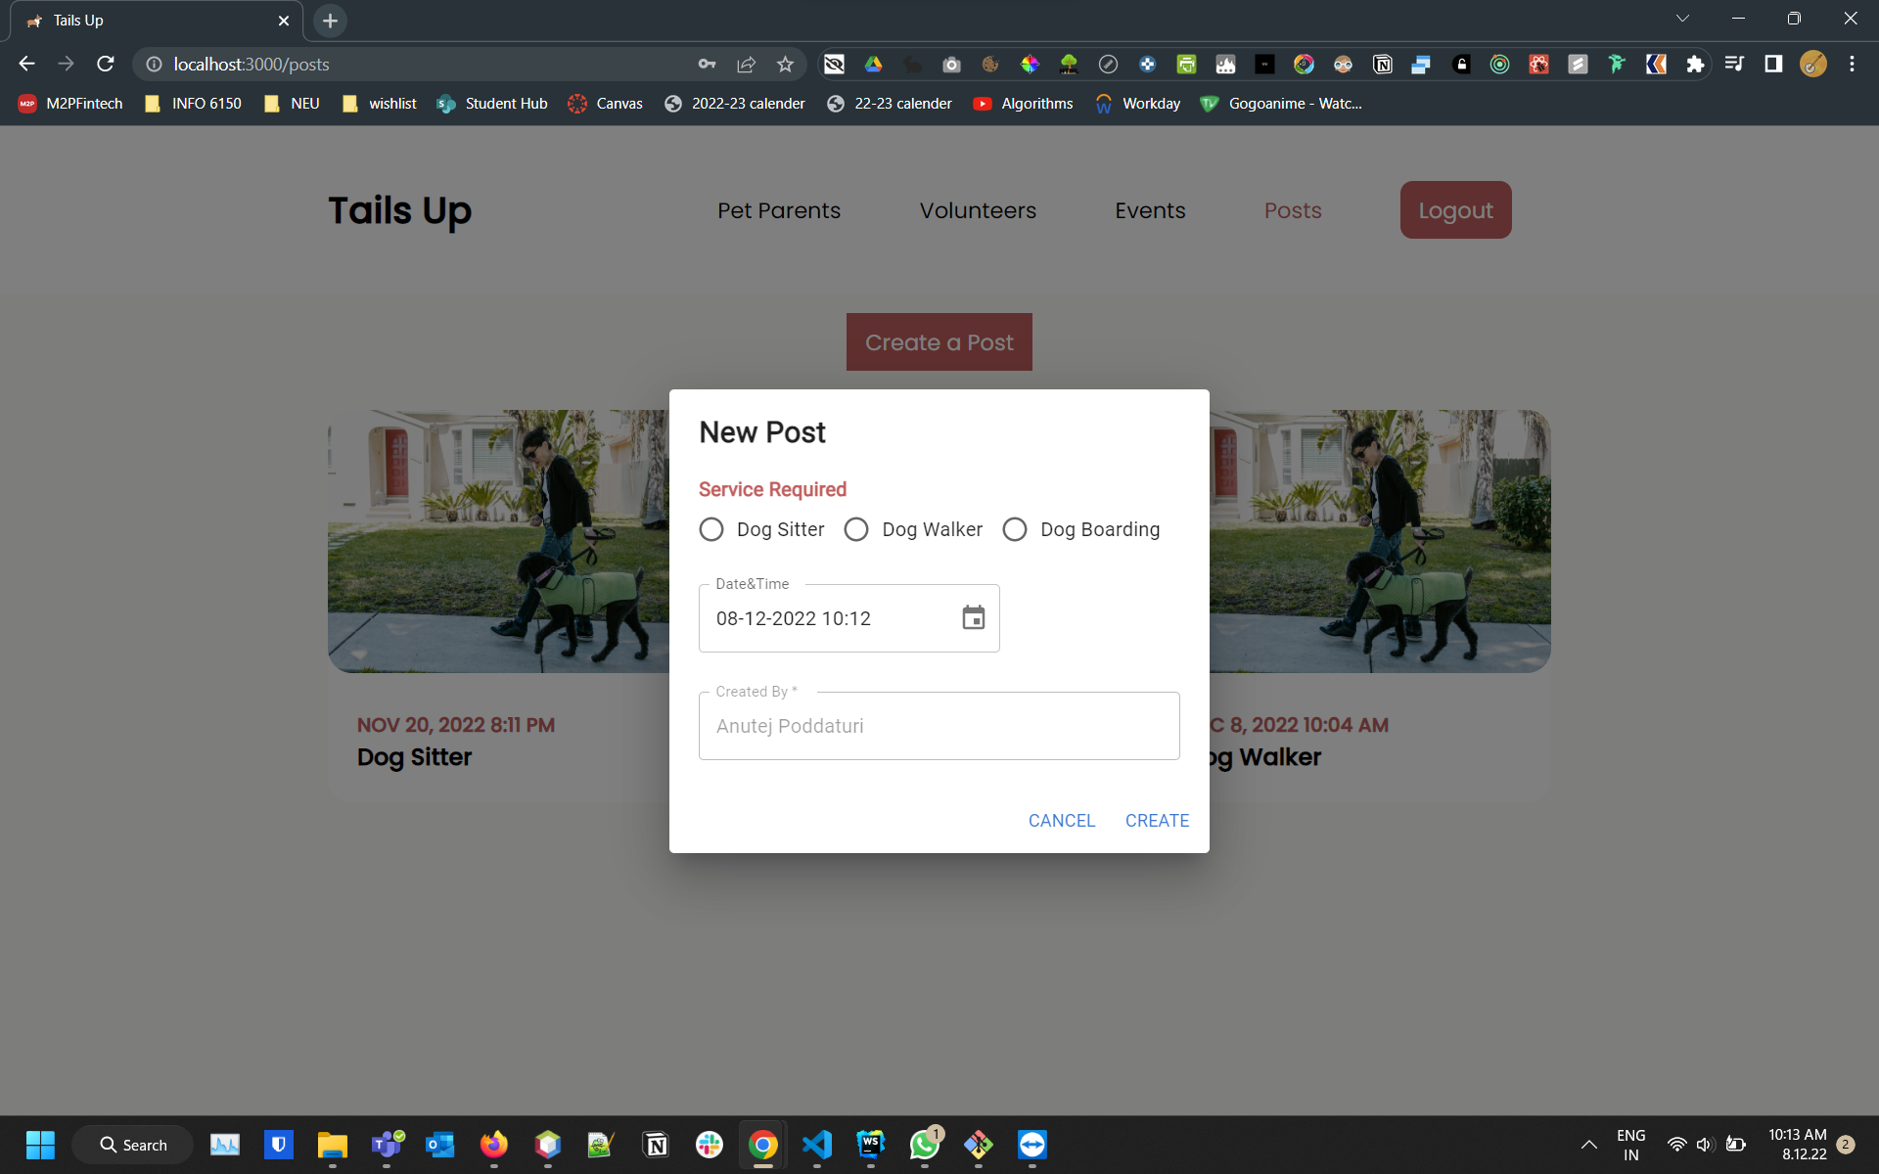
Post Creation Model

Slide 19
Thank You

